Slide 1
Amazon Book Reviews
Shashwat Mehra
INFO:7250 Big Data Engineering

Slide 2
Amazon Book Reviews (Datasets Used)
BX-Books.csv: Books are identified by their respective ISBN. Invalid ISBNs have already been removed from the dataset. Moreover, some content-based information is given (`Book-Title`, `Book-Author`, `Year-Of-Publication`, `Publisher`)
BX-BookRatings.csv: Contains the book rating information. Ratings (`Book-Rating`) are either explicit, expressed on a scale from 1-10 (higher values denoting higher appreciation), or implicit, expressed by 0
BX-Users.csv: Contains the users. Note that user IDs (`User-ID`) have been anonymized and map to integers. Demographic data is provided (`Location`, `Age`) if available.

Slide 3













Ecosystem
Web Interface
Visualizations/Spreadsheet
MapReduce(Processing using Java)
Hive
(Analytical SQL on Hadoop)
Mahout
(Machine Learning)
R (Web-Scraping)
Python
(Pre-processing of data)
EMR (Processing using AWS Component)
YARN
Resource Management
Storage

Slide 4
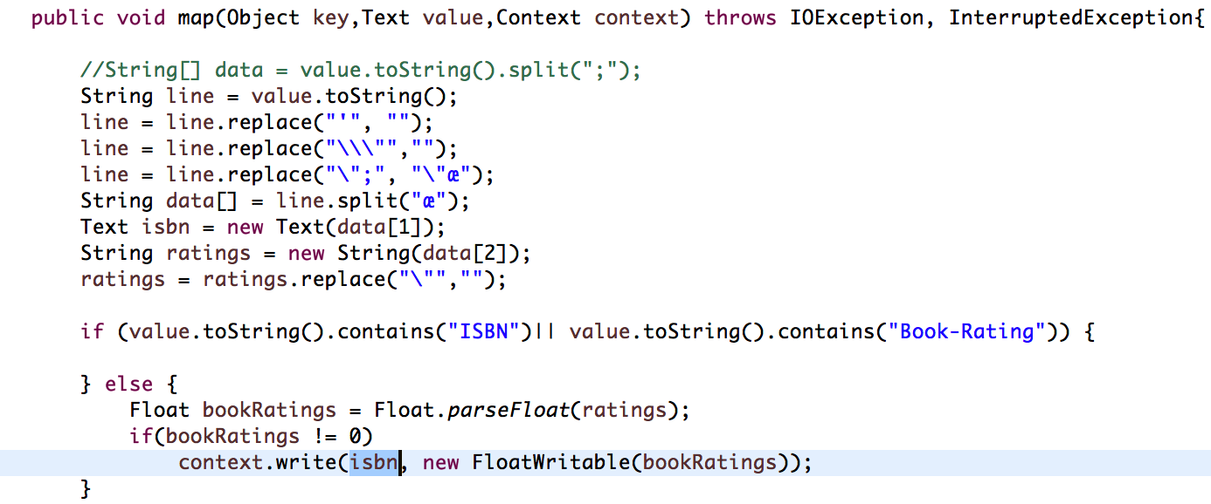
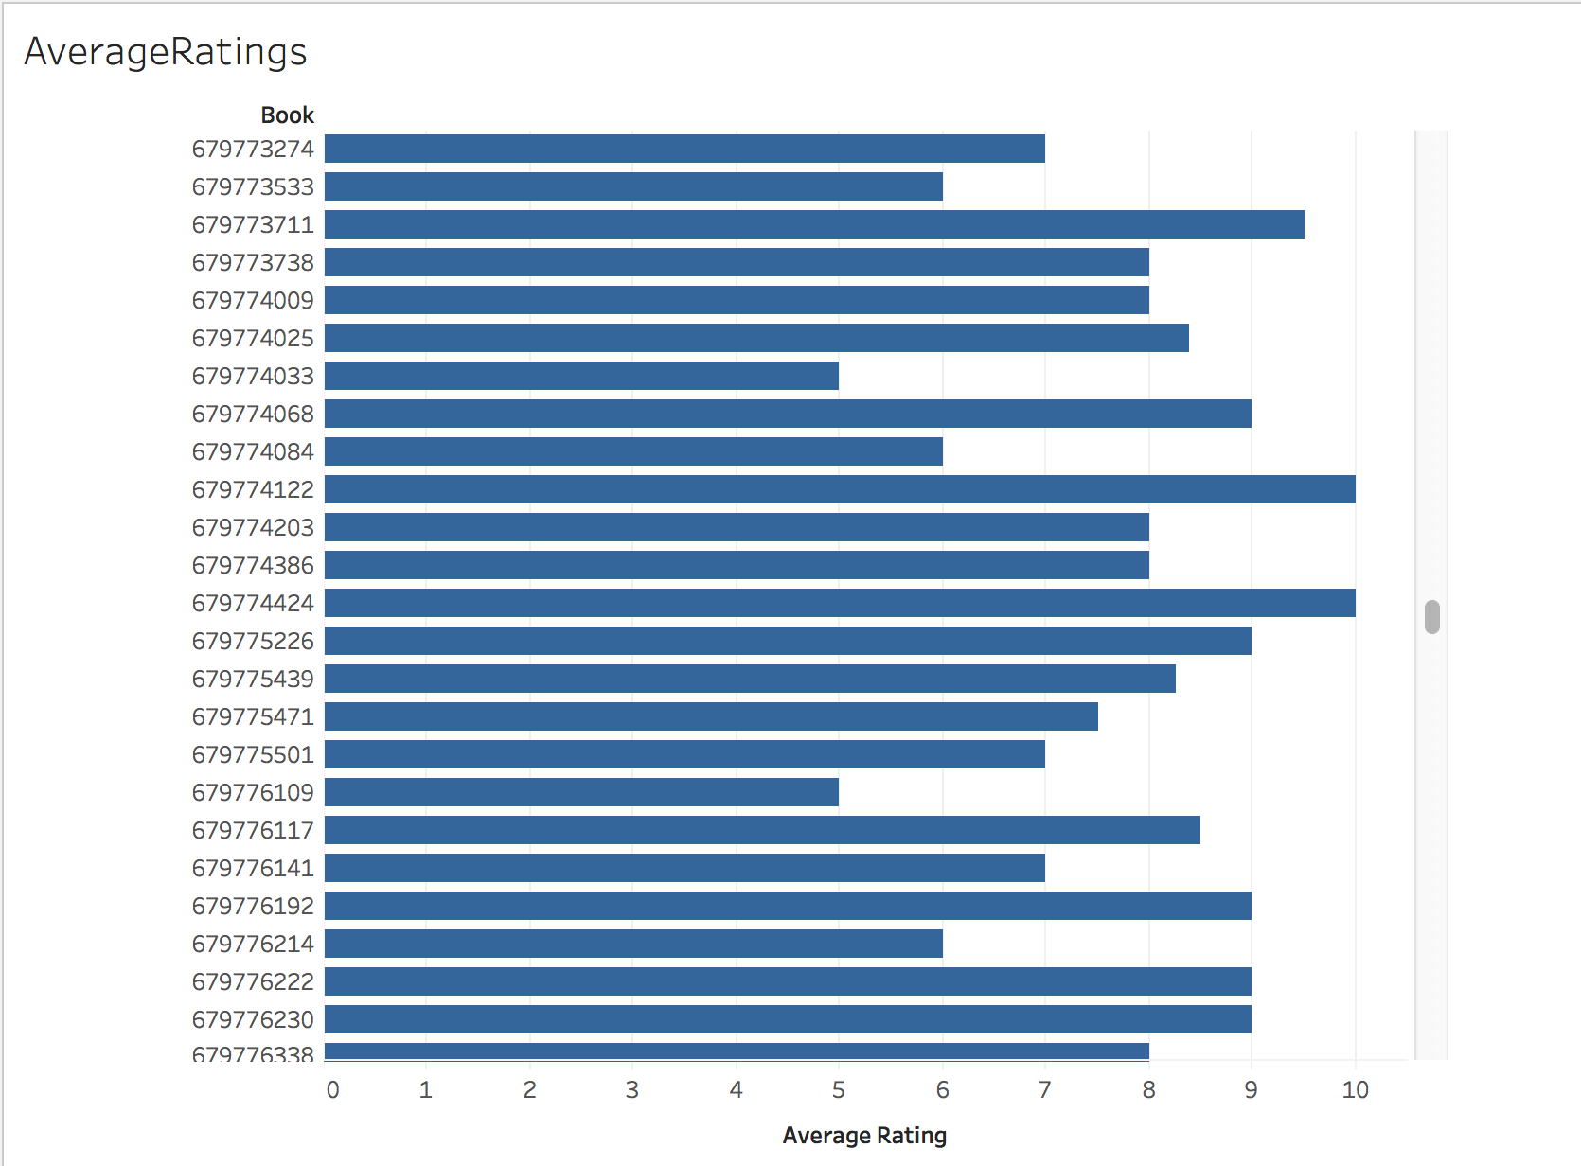
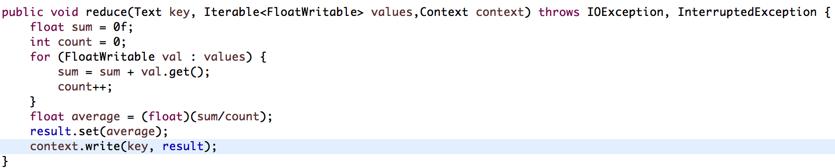
Map Reduce Analysis - 1
Mapper Code:
What are the average ratings of all the ISBN?
Reducer Code:

Slide 5
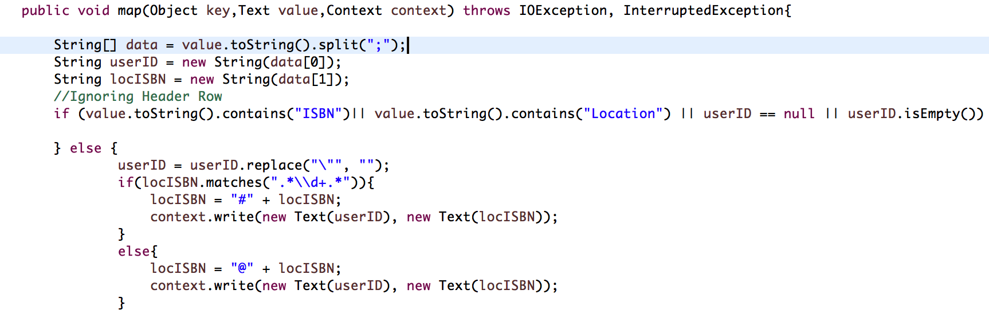
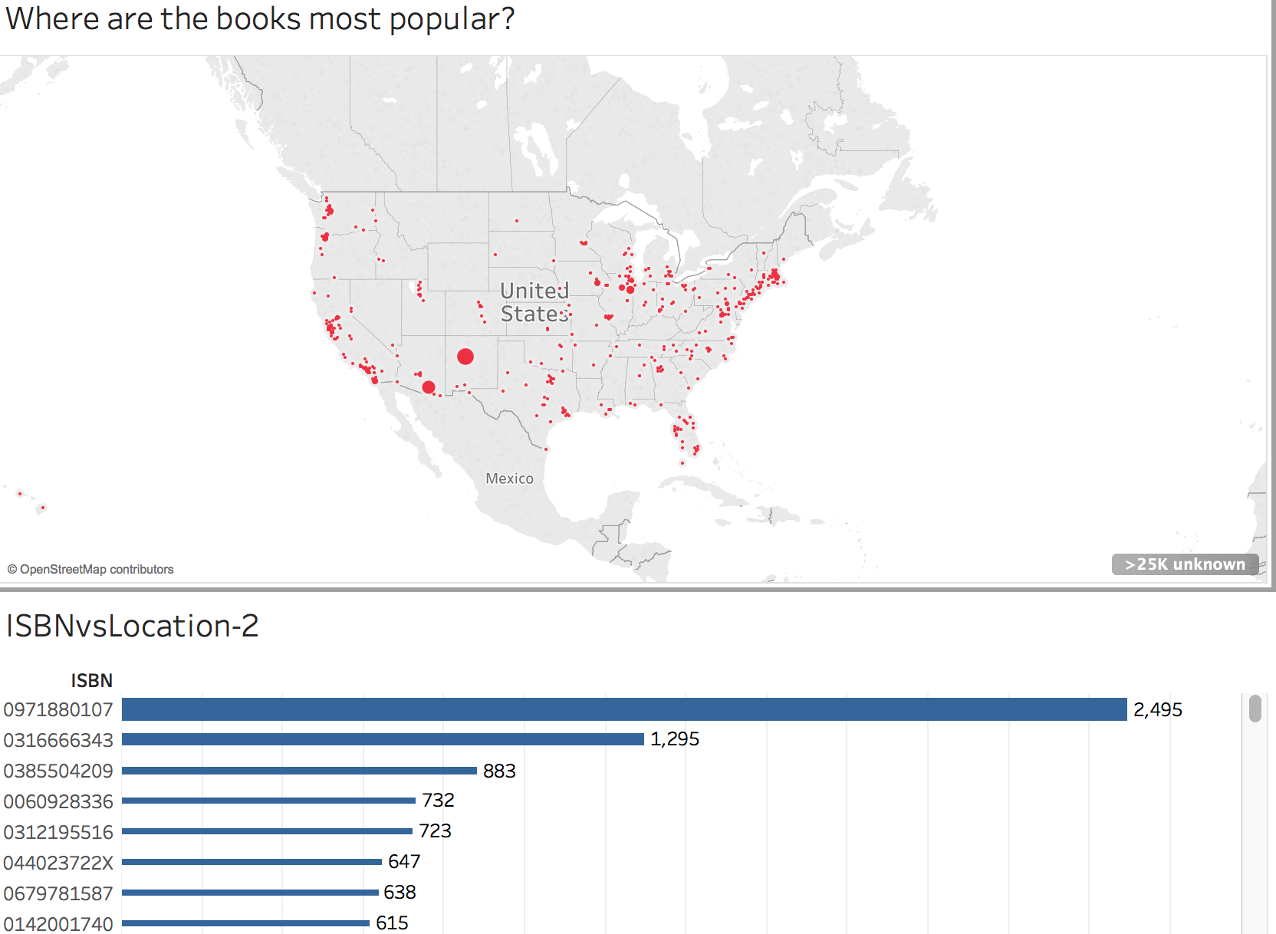
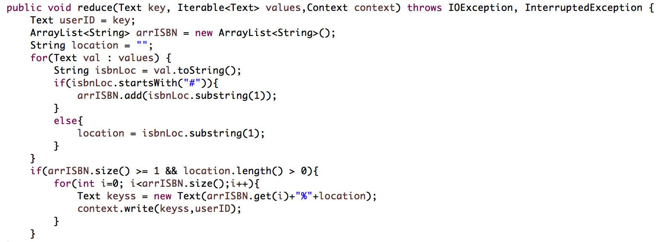
Map Reduce Analysis - 2
Mapper-1 Code:
Where are the books most popular based on location?
Reducer-1 Code:

Slide 6
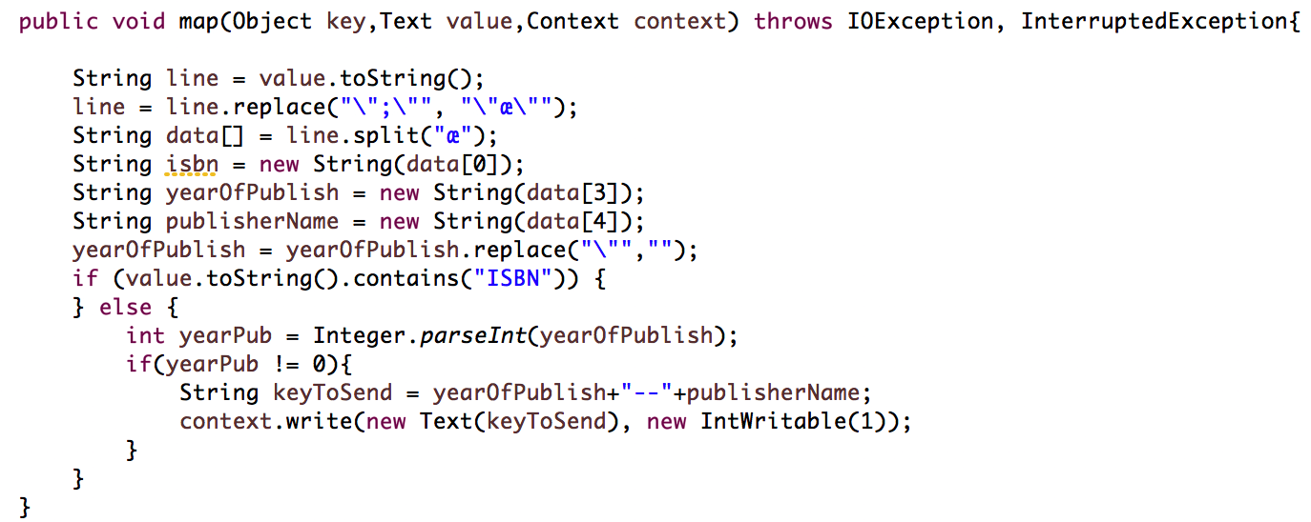
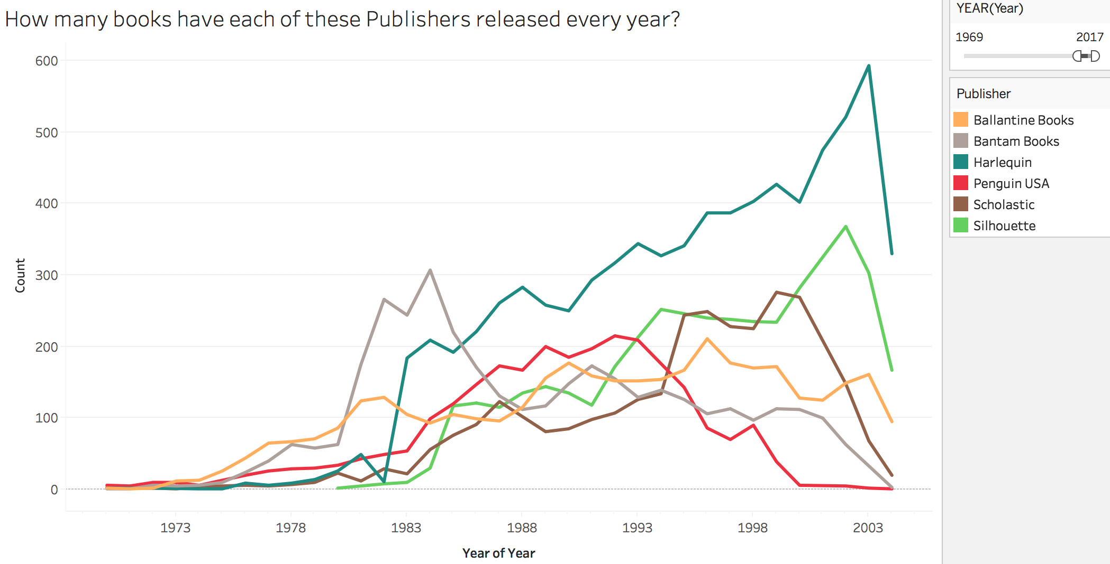
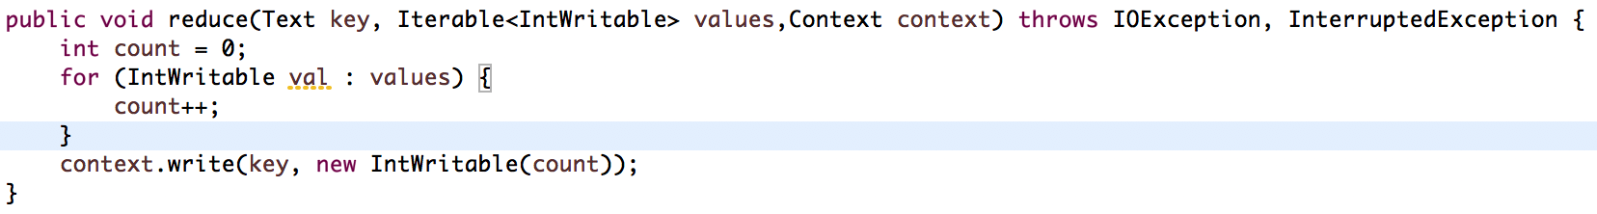
Map Reduce Analysis - 3
Mapper Code:
How many books have each Publisher released every year?
Reducer Code:

Slide 7
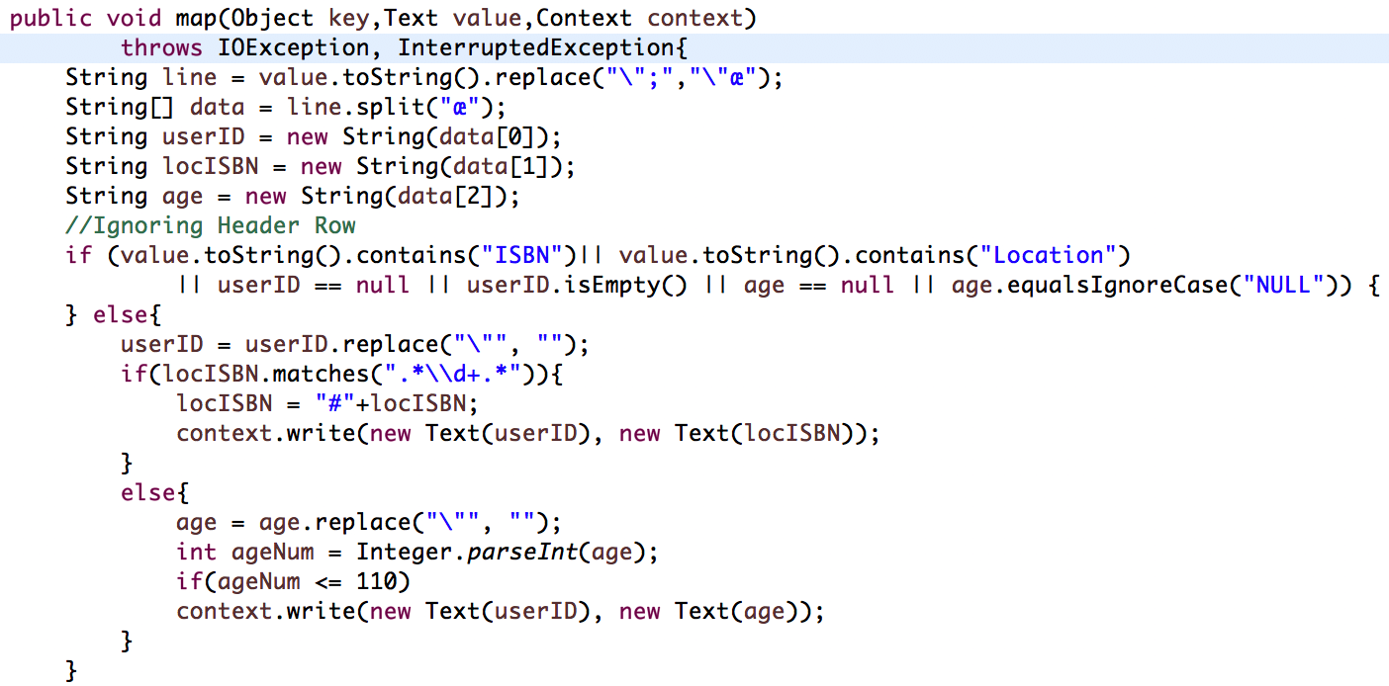
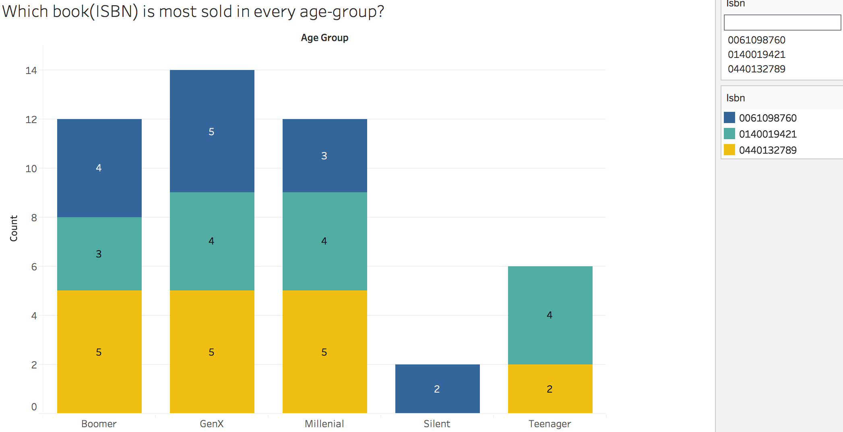
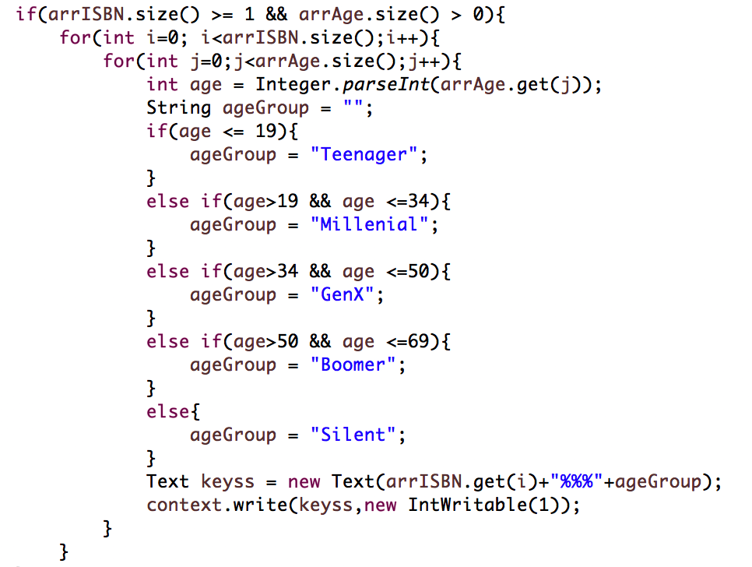
Map Reduce Analysis – 4
Mapper-1 Code:
Which book as per ISBN is sold in every age group?
Reducer-1 Code:

Slide 8
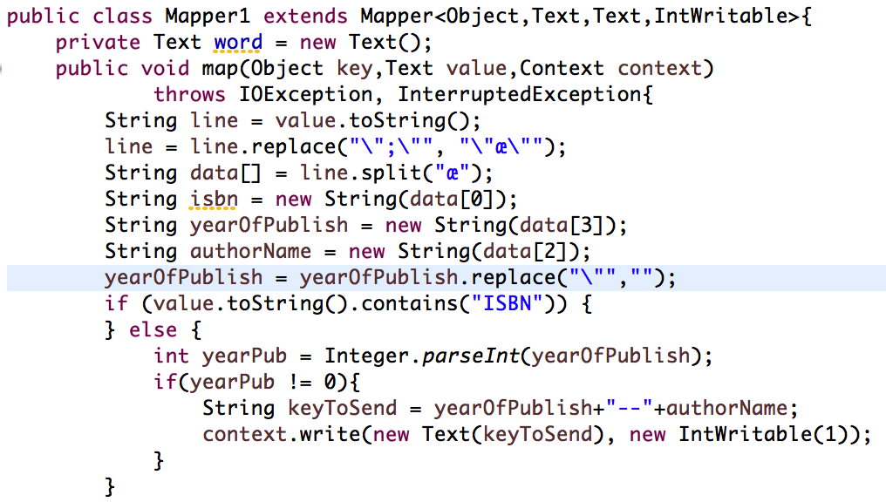
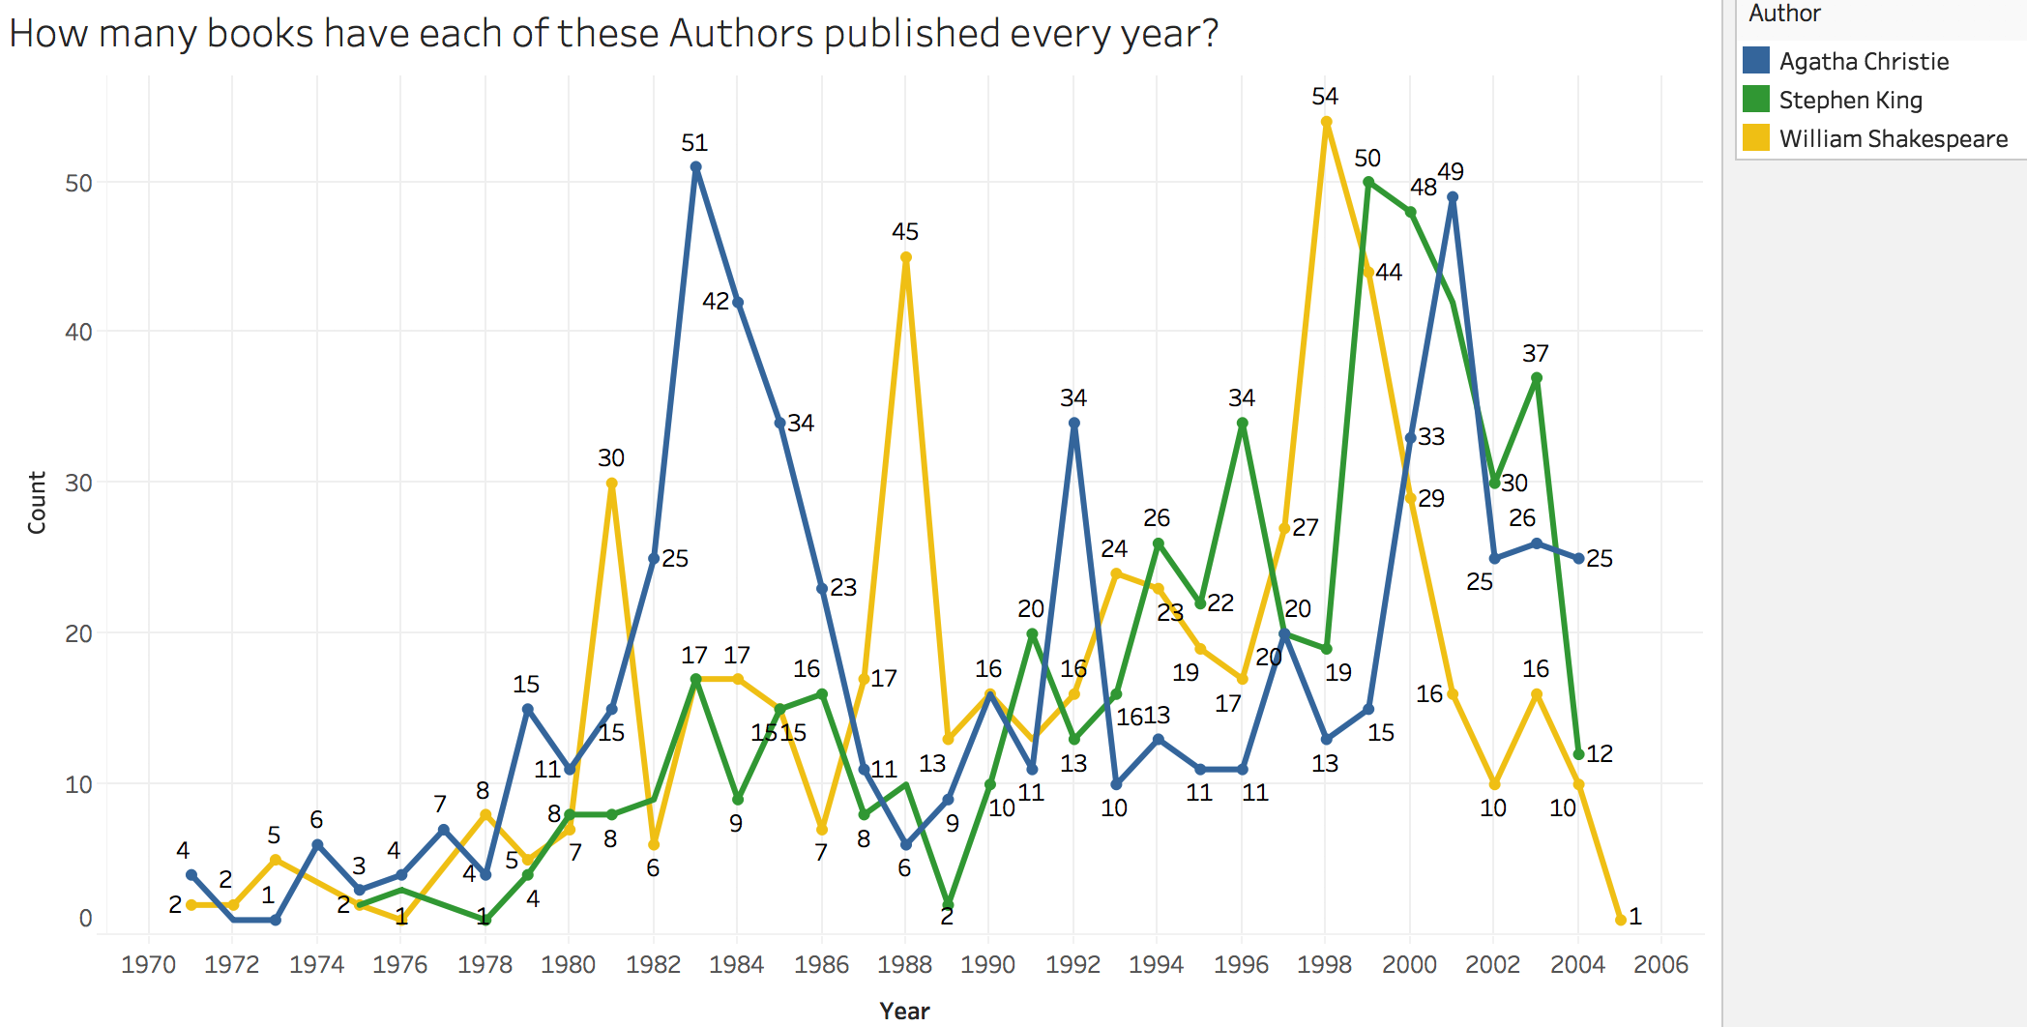
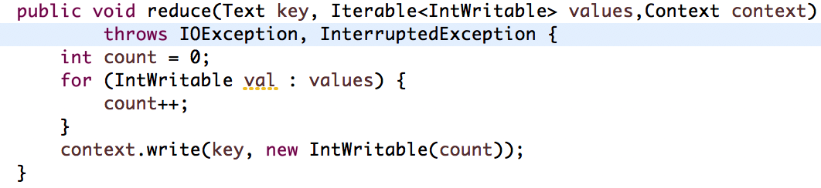
Map Reduce Analysis – 5
Mapper Code:
How many books have each Author released every year?
Reducer Code:

Slide 9
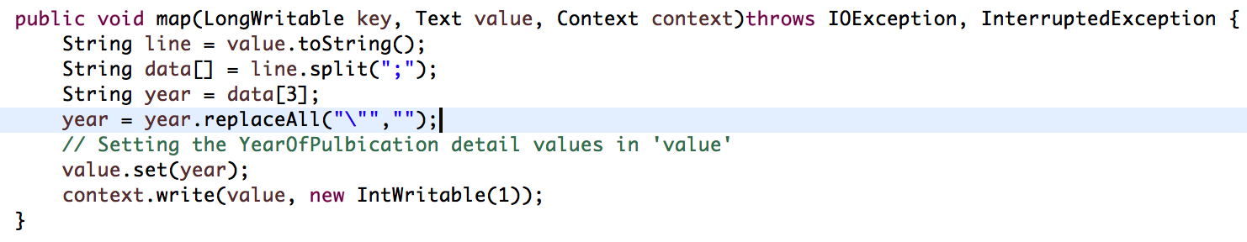
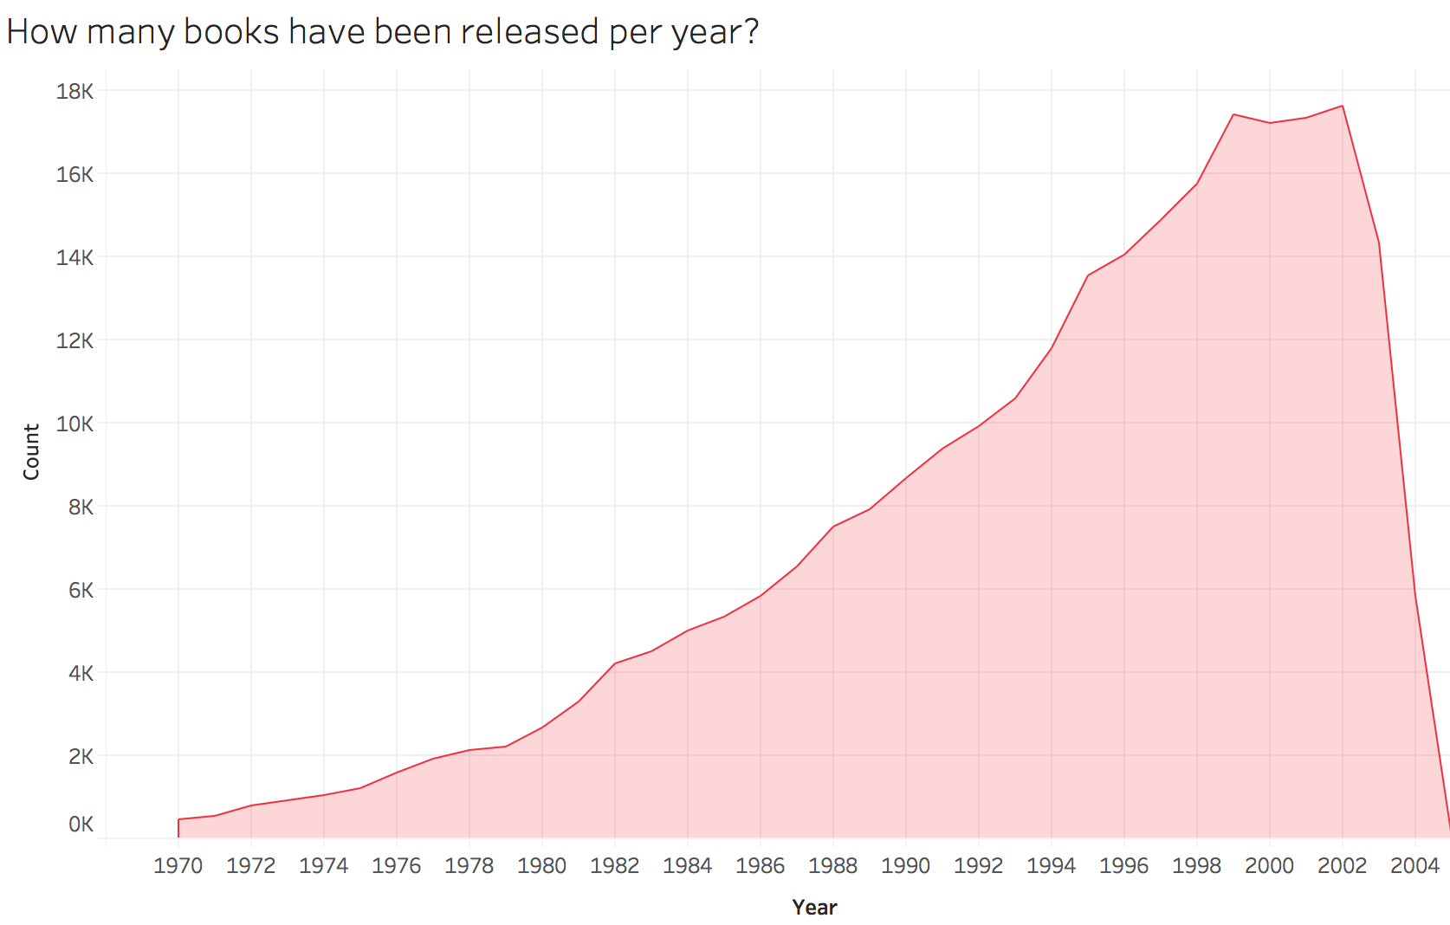
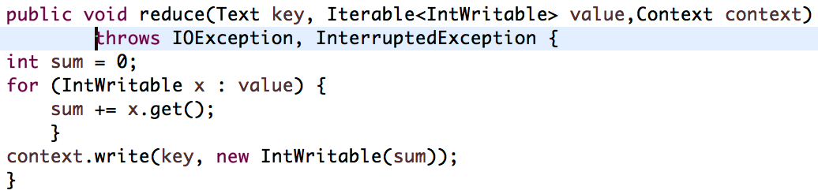
Map Reduce Analysis - 6
Mapper Code:
How many books have been released every year?
Reducer Code:

Slide 10
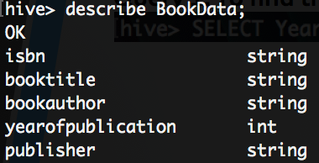
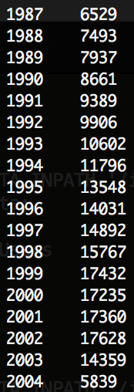
Hive Analysis (Query-1)
Query 1: To find the count of books per year.
Book-Data Table:
Query 1 Output

Slide 11
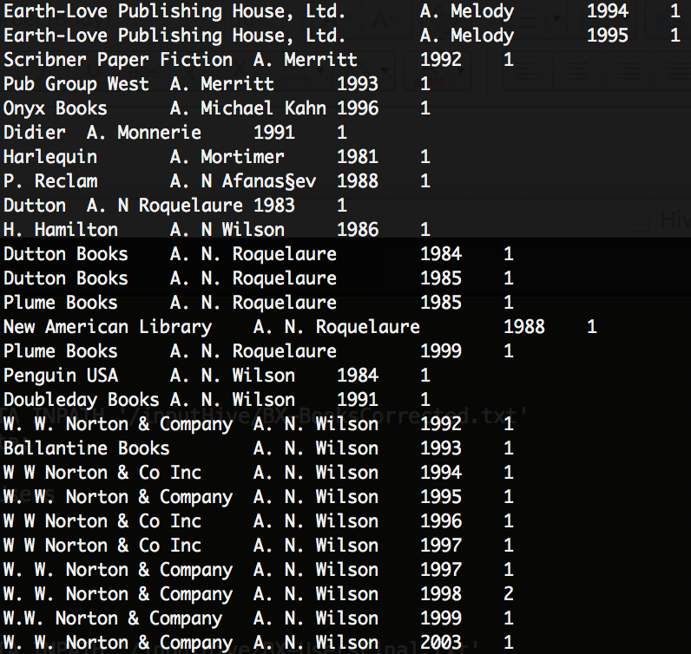
Hive Analysis (Query-2)
Query 2: To find books published each Year by Author.
Query 2 Output
Book-Data Table:

Slide 12
Mahout Recommendation
Python
(Pre-processing of data)
Mahout
(Machine Learning)

Slide 13

Sentiment Analysis
R (Web-Scraping)

Slide 14


